Slide 1
Robot Combo
Griffin Edwards, Eyal Sharon, Justin Millette

Slide 2
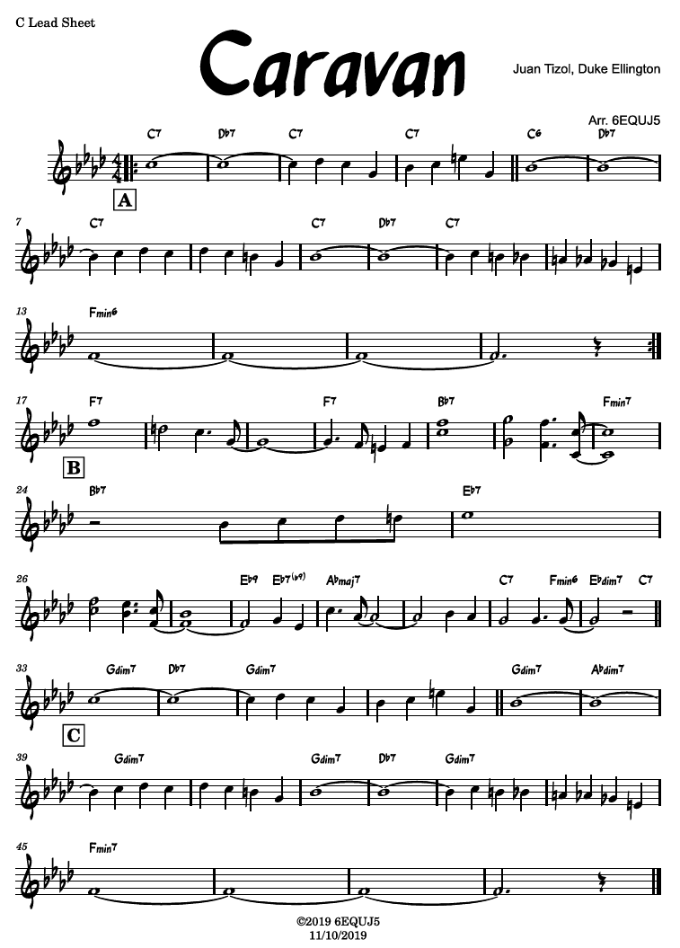
General Idea
Take in a lead sheet as a .musicxml file, then play that tune as a jazz combo.

Slide 3
General Idea
Take in a lead sheet as a .musicxml file, then play that tune as a jazz combo.
Parse lead sheet to get melody and chords

Slide 4
General Idea
Take in a lead sheet as a .musicxml file, then play that tune as a jazz combo.
Parse lead sheet to get melody and chords
Melody
Chords

Slide 5
General Idea
Take in a lead sheet as a .musicxml file, then play that tune as a jazz combo.
Assign melody to horn part
Melody
Generate piano comping
Chords
Generate walking bassline

Slide 6
General Idea
Take in a lead sheet as a .musicxml file, then play that tune as a jazz combo.
Assign melody to horn part
Melody
The “head”
Melody from lead sheet
Generated piano comping
Generated walking bassline
Generate piano comping
Chords
Generate walking bassline

Slide 7
General Idea
Take in a lead sheet as a .musicxml file, then play that tune as a jazz combo.
Form
The “head”
Melody from lead sheet
Generated piano comping
Generated walking bassline
Solo sections
Right hand piano
Double-bass solo
Saxophone solo
The head, again
Melody from lead sheet
Generated piano comping
Generated walking bassline

Slide 8
Bassline: Bucketed Markov 1-Chains
Goal: Generate walking bassline from given chord.
Walking basslines move in short steps frequently, and long jumps more infrequently.
Markov Chains are perfect for this!
…but finding data for that is challenging.
Notes:
Walking basslines move a lot, and want to move in short steps more than in long jumps. But both are acceptable.

Slide 9
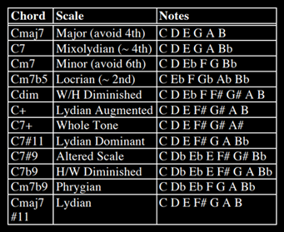
Bassline: Bucketed Markov 1-Chains
Idea: Generate Markov Chain matrices for each chord, based on the given chord quality (C7, Cm, Cmaj7 add #11)
CITE PAPER This paper gave us a good starting point of what notes we should play over a given chord:
 | C | D | E | G | A | B
C
D
E
G
A
B
Let’s look at Cmaj7
Notes:
Walking basslines move a lot, and want to move in short steps more than in long jumps. But both are acceptable.

Slide 10
Bassline: Bucketed Markov 1-Chains
Looking at Cmaj7, we see that we “should” play C, D, E, G, A, and B over this chord. We also note that Cmaj7 is built up of the notes C, E, G, and B. (This generalizes to any maj7 chord.)
So we can build the outline of our matrix:
 | C | D | E | G | A | B
C
D
E
G
A
B
Notes:
Walking basslines move a lot, and want to move in short steps more than in long jumps. But both are acceptable.

Slide 11
Bassline: Bucketed Markov 1-Chains
A walking bassline can choose the same note, just rarely.
 | C | D | E | G | A | B
C | .05
D |  | .05
E |  |  | .05
G |  |  |  | .05
A |  |  |  |  | .05
B |  |  |  |  |  | .05
Notes:
Walking basslines move a lot, and want to move in short steps more than in long jumps. But both are acceptable.

Slide 12
Bassline: Bucketed Markov 1-Chains
The “bucket” is like a bag of marbles that we draw from, where each marble represents a note to move to.
There are different buckets for each “previous” note (each row)
 | C | D | E | G | A | B
C | .05
D |  | .05
E |  |  | .05
G |  |  |  | .05
A |  |  |  |  | .05
B |  |  |  |  |  | .05
Previous note: C
Choose from: [ ]
Notes:
Walking basslines move a lot, and want to move in short steps more than in long jumps. But both are acceptable.

Slide 13
Bassline: Bucketed Markov 1-Chains
The “bucket” is like a bag of marbles that we draw from, where each marble represents a note to move to.
There are different buckets for each “previous” note (each row)
Each note must have at least a chance of being selected, so add a marble for each.
Previous note: C
Choose from: [D E G A B]
 | C | D | E | G | A | B
C | .05
D |  | .05
E |  |  | .05
G |  |  |  | .05
A |  |  |  |  | .05
B |  |  |  |  |  | .05
Notes:
Walking basslines move a lot, and want to move in short steps more than in long jumps. But both are acceptable.

Slide 14
Bassline: Bucketed Markov 1-Chains
It’s nice to alternate between chord tones and non-chord tones, but this isn’t that strict. We add a marble for each non-chord tone in a chord tone’s bucket, and do the converse as well. So for C, we add a marble for D and A
Previous note: C
Choose from: [D D E G A A B]
 | C | D | E | G | A | B
C | .05
D |  | .05
E |  |  | .05
G |  |  |  | .05
A |  |  |  |  | .05
B |  |  |  |  |  | .05
Notes:
Walking basslines move a lot, and want to move in short steps more than in long jumps. But both are acceptable.

Slide 15
Bassline: Bucketed Markov 1-Chains
Close motion is better! So add another marble for each note adjacent to where we just were.
Previous note: C
Choose from: [D D D E G A A B]
 | C | D | E | G | A | B
C | .05
D |  | .05
E |  |  | .05
G |  |  |  | .05
A |  |  |  |  | .05
B |  |  |  |  |  | .05
Notes:
Walking basslines move a lot, and want to move in short steps more than in long jumps. But both are acceptable.

Slide 16
Bassline: Bucketed Markov 1-Chains
Now we convert these marbles into probabilities:
Previous note: C
Choose from: [D D D E G A A B]
Next note: D?
Choose from: [D D D E G A A B] = 3/8
Next note: E?
Choose from: [D D D E G A A B] = 1/8 and so on…
 | C | D | E | G | A | B
C | .05
D |  | .05
E |  |  | .05
G |  |  |  | .05
A |  |  |  |  | .05
B |  |  |  |  |  | .05
Notes:
Walking basslines move a lot, and want to move in short steps more than in long jumps. But both are acceptable.

Slide 17
Bassline: Bucketed Markov 1-Chains
Now we convert these marbles into probabilities, and multiply by .95 because of the 5% chance of choosing the same note again:
Previous note: C
Choose from: [D D D E G A A B]
 | C | D | E | G | A | B
C | .05 | 0.35625 | 0.11875 | 0.11875 | 0.23750 | 0.11875
D |  | .05
E |  |  | .05
G |  |  |  | .05
A |  |  |  |  | .05
B |  |  |  |  |  | .05
Notes:
Walking basslines move a lot, and want to move in short steps more than in long jumps. But both are acceptable.

Slide 18
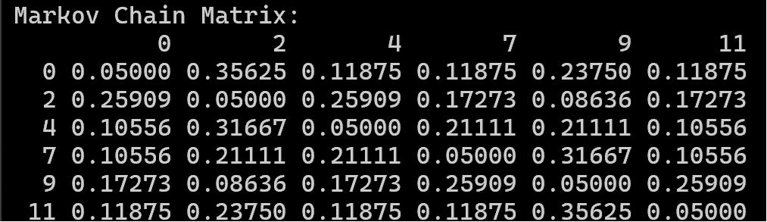
Bassline: Bucketed Markov 1-Chains
We repeat this for each row, and then we’re done!
Notes:
Walking basslines move a lot, and want to move in short steps more than in long jumps. But both are acceptable.

Slide 19
Bassline: Bucketed Markov 1-Chains
We repeat this for each row, and then we’re done!
We repeat this entire process for each chord quality.
Notes:
Walking basslines move a lot, and want to move in short steps more than in long jumps. But both are acceptable.

Slide 20
Piano Accompaniment: MC rhythm selection
Iterate over the chords being played:
Generate a MC rhythm that spans a given chord
Fill each chord-space with valid notes and rests
Identify note options to combine for an accompaniment chord
Include notes based on weights for certain intervals
Map notes and rests to MC rhythm
Adjust # of attacks based on short/long rhythm length
Notes:
Walking basslines move a lot, and want to move in short steps more than in long jumps. But both are acceptable.

Slide 21
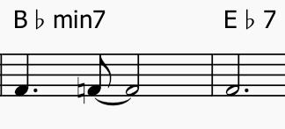
Piano Accompaniment: MC rhythm selection
Iterate over the chords being played:
Generate a MC rhythm that spans a given chord
4.0 = [0.5, 2, 1, 0.5]
Notes:
Walking basslines move a lot, and want to move in short steps more than in long jumps. But both are acceptable.

Slide 22
Piano Accompaniment: MC rhythm selection
Iterate over the chords being played:
Generate a MC rhythm that spans a given chord
Fill each chord-space with valid pitches and rests
4.0 = [0.5, 2, 1, 0.5]
Notes:
Walking basslines move a lot, and want to move in short steps more than in long jumps. But both are acceptable.

Slide 23
Piano Accompaniment: MC rhythm selection
Chord: Bb m7:
Notes:
[0, 3, 7, 10],
Probs:
0 : 0
3,4 : 0.9
7 : 0.25
10,11: 0.9
ELSE : 0.6
Iterate over the chords being played:
Generate a MC rhythm that spans a given chord
Fill each chord-space with valid pitches and rests
4.0 = [0.5, 2, 1, 0.5]
Notes:
Walking basslines move a lot, and want to move in short steps more than in long jumps. But both are acceptable.

Slide 24

Piano Accompaniment: MC rhythm selection
Chord: Bb m7:
Notes:
[0, 3, 7, 10],
Probs:
0 : 0
3,4 : 0.9
7 : 0.25
10,11: 0.9
ELSE : 0.6
Iterate over the chords being played:
Generate a MC rhythm that spans a given chord
Fill each chord-space with valid pitches and rests
4.0 = [0.5, 2, 1, 0.5]
Melody
Piano
Notes:
Walking basslines move a lot, and want to move in short steps more than in long jumps. But both are acceptable.

